Slide 1
Introduction to Applied Statistics: Data Transformations and T-tests
Lynn Waterhouse

Slide 2
Learning Objectives
Apply simple transformations if data are not normal
Data transformation (log)
T-tests: Independent and Paired
Explain when a T-test is appropriate
Explain the assumptions of a T-test
Explain when a paired t-test is appropriate
Non-parametric T-tests

Slide 3
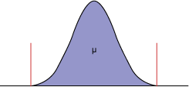
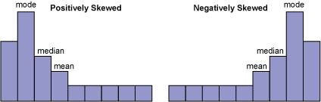
Data Transformations
Common transformations:
Log
Square root
Right skewed
Left skewed

Slide 4
Data Transformations
Common transformations:
Log
Square root
Right skewed
Left skewed

Slide 5
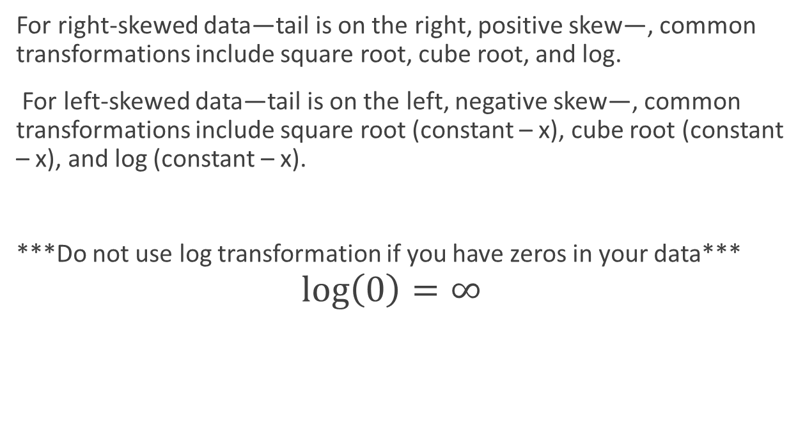
Log & Sqrt Transformations
For right-skewed data—tail is on the right, positive skew—, common transformations include square root, cube root, and log.
For left-skewed data—tail is on the left, negative skew—, common transformations include square root (constant – x), cube root (constant – x), and log (constant – x).
***Do not use log transformation if you have zeros in your data***
$$\log\left(0\right)=∞$$
R script time

Slide 6
Cautionary Warning About Using Tests for Normality
Null is that distribution is normal
When the sample size is small, even big departures from normality are not detected, and when your sample size is large, even the smallest deviation from normality will lead to a rejected null.
R script time

Slide 7
T-tests

Slide 8

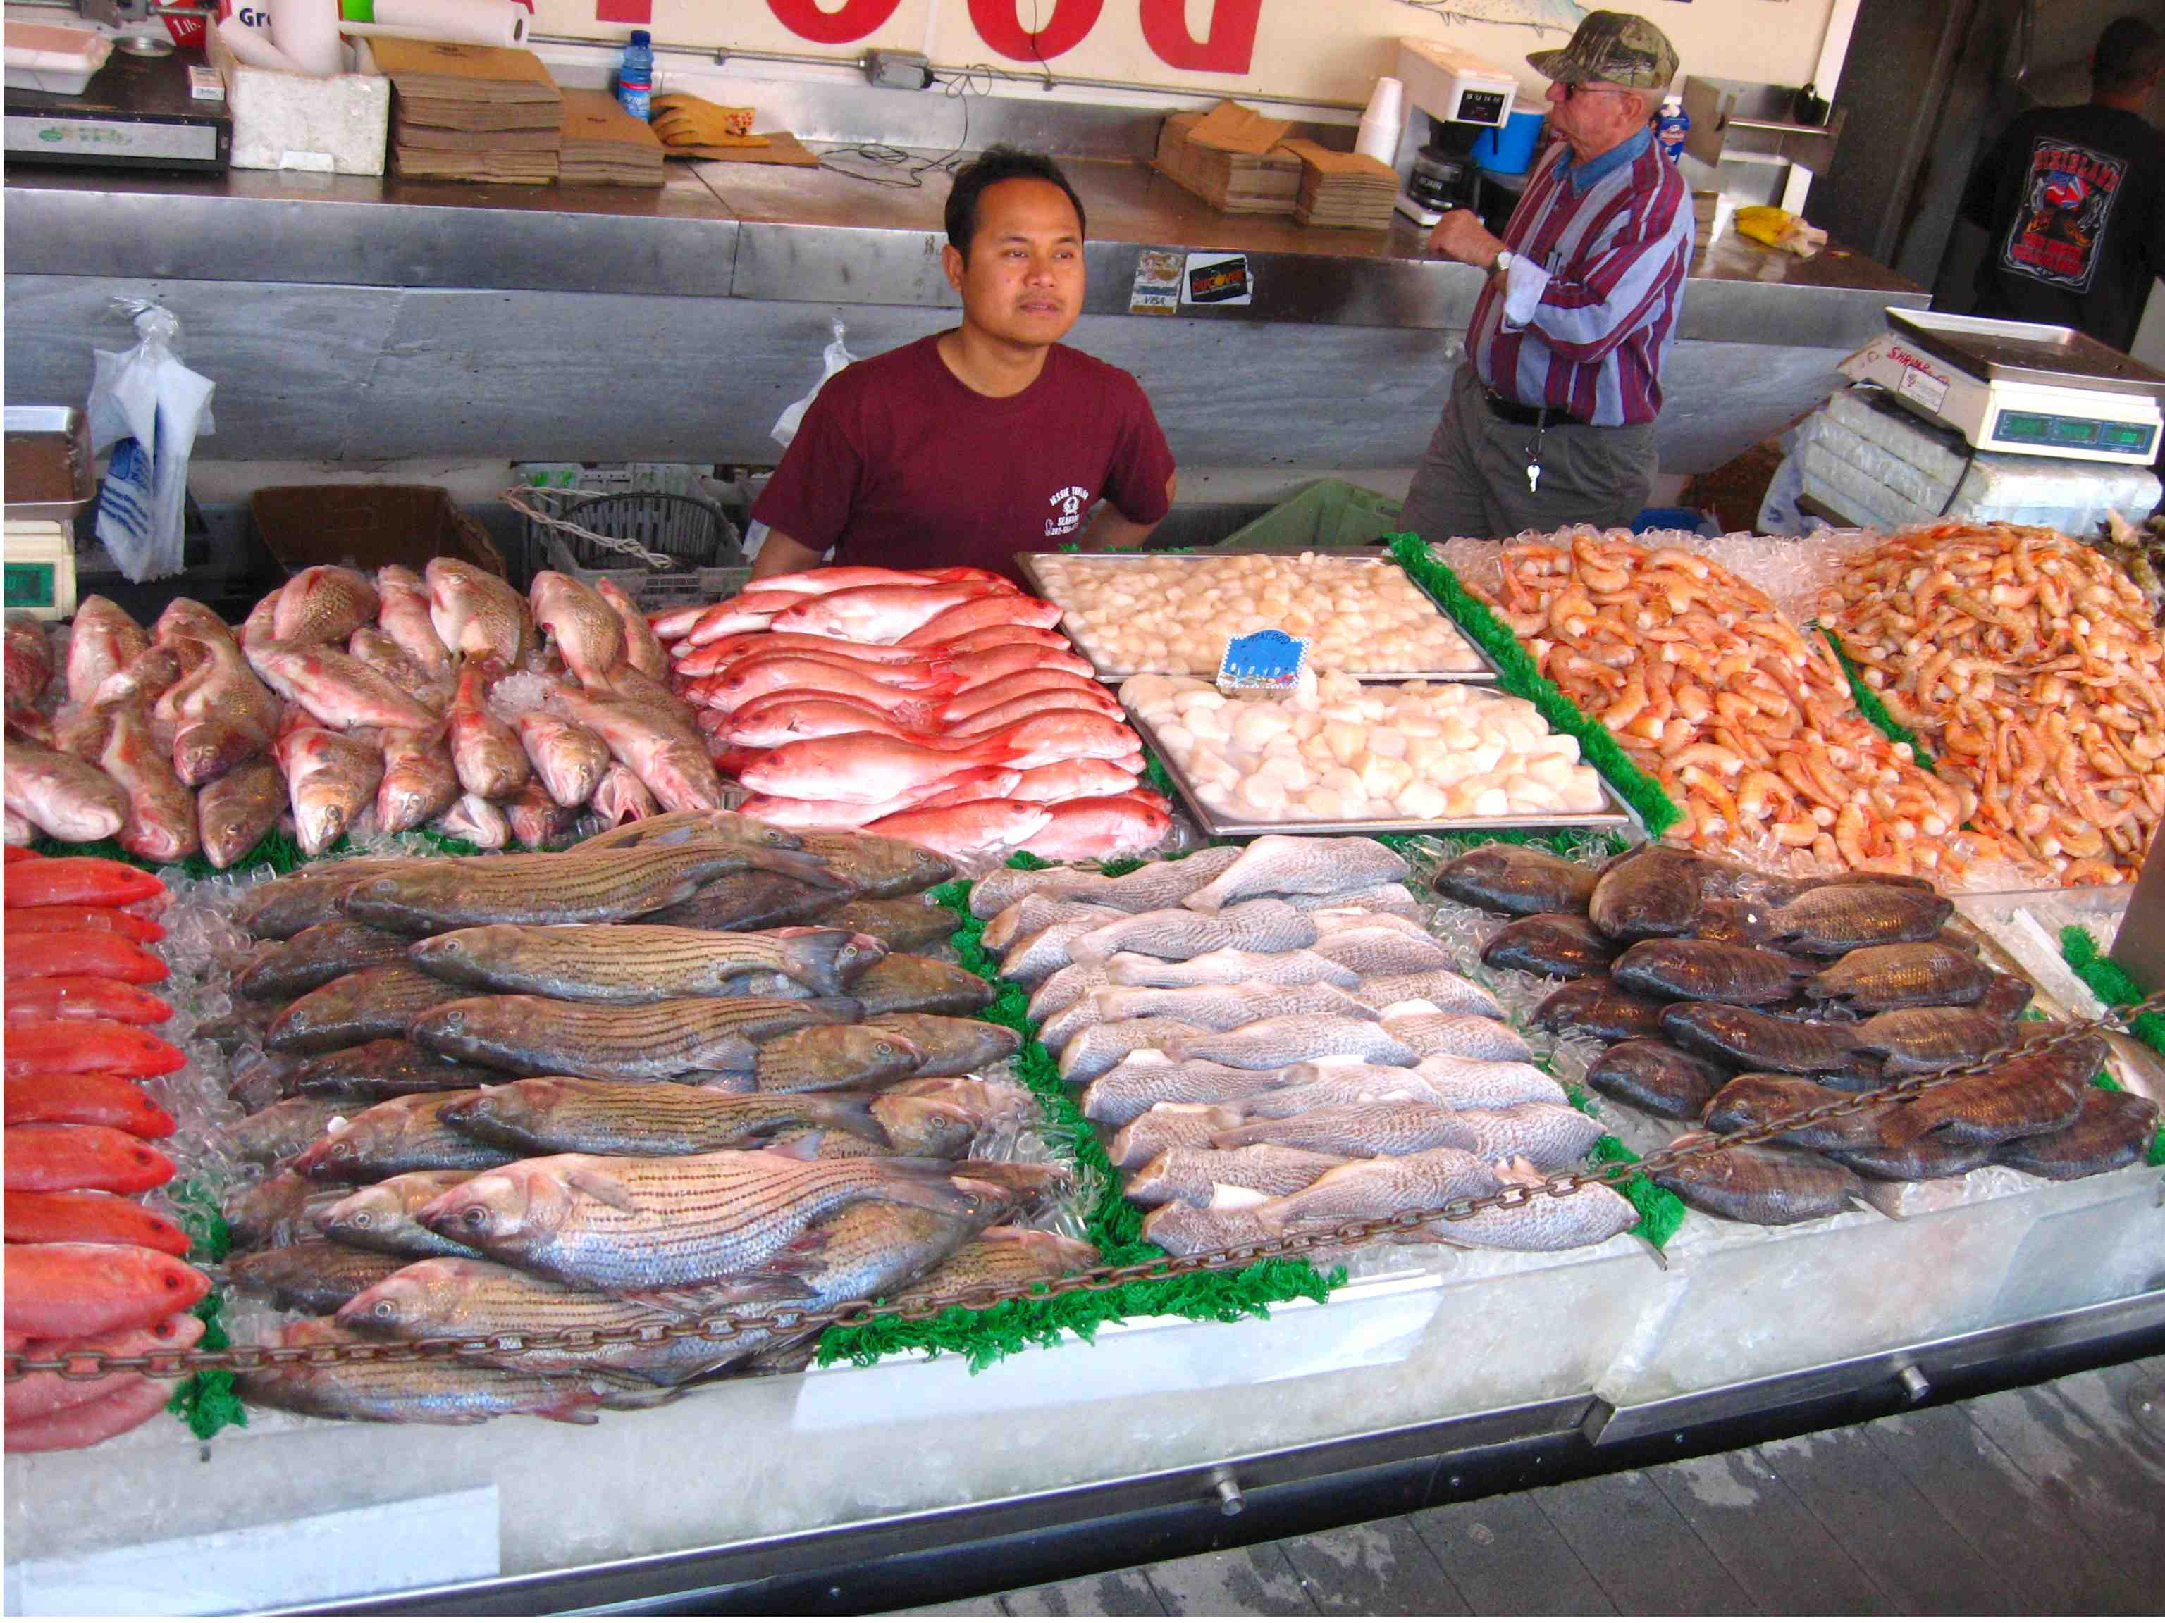
What do you notice?

Slide 9





Notes:
Yesterday we collected tree diameters

Slide 10
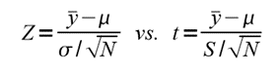
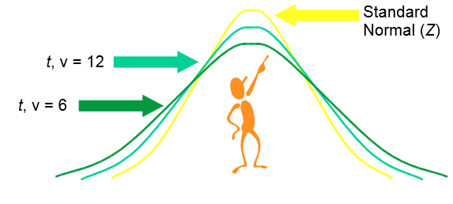
Introduction to T-distribution
Very similar to the standard normal distribution (Z-distribution, normal distribution with mean=0, std. dev=1)
The T and Z distribution become more similar when sample size (N) >30
T-distribution can be used to make inferences about the mean
Used when population sd is unknown but we know the sample sd (σ vs. S)

Slide 11
How to look for differences in data (One Sample T-test)
One Sample T-test
Test something about average of data
Assumptions:
Continuous variable
Independent observations
Variable follows a normal distribution (bell-shaped)

Slide 12
One Sample T-test
Useful when you want to compare the mean to a known number
Pieces of information required:
Sample size
Sample mean
Sample standard deviation
Population mean being compared to

Slide 13
One Sample T-test
Example: The mean weight of abalone sold at market in a package is listed as 500g, you want to check if the abalone sold in the market have a mean of 500g. You have a sample of 30 abalone. The mean is 493.6667g and the sample standard deviation 18.02552g.
475 505 521 453 508 510 488 489 488 482 490 480 484 501 519 497 489 481 483 548 502 490 491 509 486 471 511 479 499 481
Null Hypothesis:
??
Alternative Hypothesis:
??

Slide 14
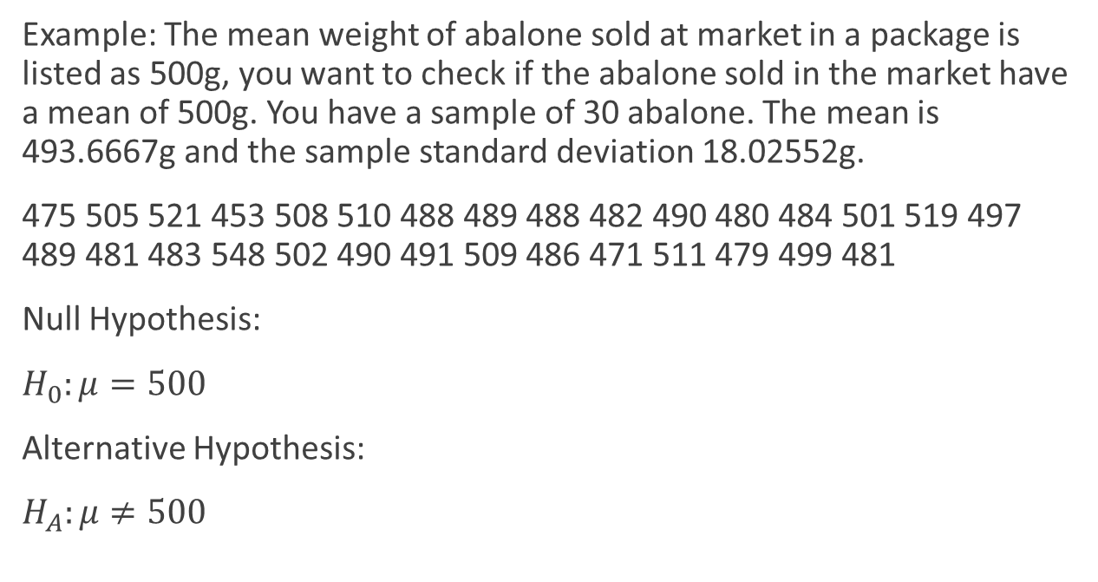
One Sample T-test
Example: The mean weight of abalone sold at market in a package is listed as 500g, you want to check if the abalone sold in the market have a mean of 500g. You have a sample of 30 abalone. The mean is 493.6667g and the sample standard deviation 18.02552g.
475 505 521 453 508 510 488 489 488 482 490 480 484 501 519 497 489 481 483 548 502 490 491 509 486 471 511 479 499 481
Null Hypothesis:
$H_{0}:μ=500$
Alternative Hypothesis:
$H_{A}:μ≠500$

Slide 15
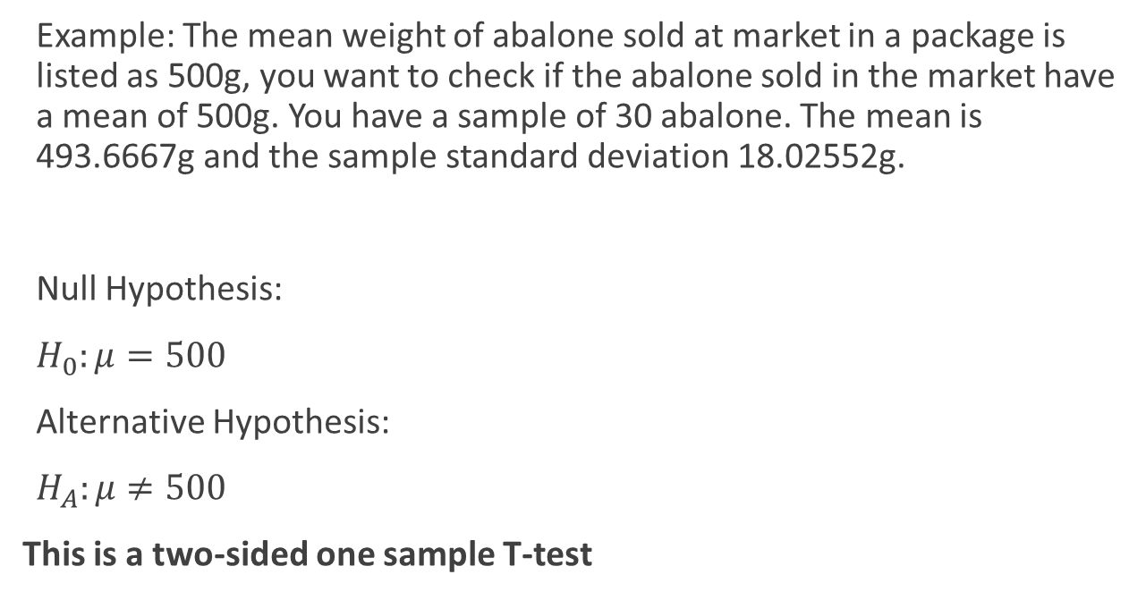
One Sample T-test
Example: The mean weight of abalone sold at market in a package is listed as 500g, you want to check if the abalone sold in the market have a mean of 500g. You have a sample of 30 abalone. The mean is 493.6667g and the sample standard deviation 18.02552g.
Null Hypothesis:
$H_{0}:μ=500$
Alternative Hypothesis:
$H_{A}:μ≠500$
This is a two-sided one sample T-test

Slide 16
One Sample T-test
Example: The mean weight of abalone sold at market in a package is listed as 500g, you want to check if the abalone sold in the market have a mean of 500g. You have a sample of 30 abalone. The mean is 493.6667g and the sample standard deviation 18.02552g.
R script time

Slide 17
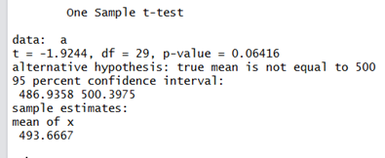
One Sample T-test
Example: The mean weight of abalone sold at market in a package is listed as 500g, you want to check if the abalone sold in the market have a mean of 500g. You have a sample of 30 abalone. The mean is 493.6667g and the sample standard deviation 18.02552g.
So what do we conclude?

Slide 18
One Sample T-test
Example: The mean weight of abalone sold at market in a package is listed as 500g, you want to check if the abalone sold in the market have a mean of 500g. You have a sample of 30 abalone. The mean is 493.6667g and the sample standard deviation 18.02552g.

Slide 19
One Sample T-test
Example: The mean weight of abalone sold at market in a package is listed as 500g, you want to check if the abalone sold in the market have a mean of 500g. You have a sample of 30 abalone. The mean is 493.6667g and the sample standard deviation 18.02552g.
p>0.05 fail to reject the null.

Slide 20
One Sample T-test
Example: The mean weight of abalone sold at market in a package is listed as 500g, you want to check if the abalone sold in the market have a mean of 500g. You have a sample of 30 abalone. The mean is 493.6667g and the sample standard deviation 18.02552g.
*There is not enough evidence to say that there is a statistically significant difference between our sample and the expected mean of 500g.

Slide 21
One Sample T-test
Example: The mean weight of abalone sold at market in a package is listed as 500g, you want to check if the abalone sold in the market have a mean of 500g. You have a sample of 30 abalone. The mean is 493.6667g and the sample standard deviation 18.02552g.

Slide 22
One Sample T-test
Example: The mean weight of abalone sold at market in a package is listed as 500g, you want to check if the abalone sold in the market have a mean of 500g. You have a sample of 30 abalone. The mean is 493.6667g and the sample standard deviation 18.02552g.

Slide 23
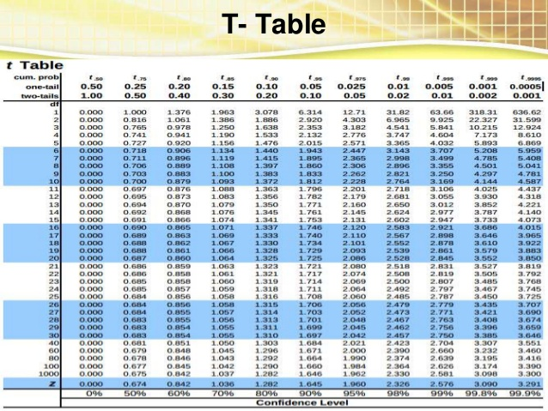
One Sample T-test
t = -1.9244 df=29
Example: The mean weight of abalone sold at market in a package is listed as 500g, you want to check if the abalone sold in the market have a mean of 500g. You have a sample of 30 abalone. The mean is 493.6667g and the sample standard deviation 18.02552g.
https://image.slidesharecdn.com/hypothesistesting47-160103171329/95/hypothesis-testing-47-7-638.jpg?cb=1451841291

Slide 24
One Sample T-test
t = -1.9244 df=29
Example: The mean weight of abalone sold at market in a package is listed as 500g, you want to check if the abalone sold in the market have a mean of 500g. You have a sample of 30 abalone. The mean is 493.6667g and the sample standard deviation 18.02552g.
https://image.slidesharecdn.com/hypothesistesting47-160103171329/95/hypothesis-testing-47-7-638.jpg?cb=1451841291

Slide 25
One Sample T-test
t = -1.9244 df=29
Example: The mean weight of abalone sold at market in a package is listed as 500g, you want to check if the abalone sold in the market have a mean of 500g. You have a sample of 30 abalone. The mean is 493.6667g and the sample standard deviation 18.02552g.
https://image.slidesharecdn.com/hypothesistesting47-160103171329/95/hypothesis-testing-47-7-638.jpg?cb=1451841291

Slide 26
One Sample T-test
t = -1.9244 df=29
Example: The mean weight of abalone sold at market in a package is listed as 500g, you want to check if the abalone sold in the market have a mean of 500g. You have a sample of 30 abalone. The mean is 493.6667g and the sample standard deviation 18.02552g.
https://image.slidesharecdn.com/hypothesistesting47-160103171329/95/hypothesis-testing-47-7-638.jpg?cb=1451841291

Slide 27
One Sample T-test
Example: The mean weight of abalone sold at market in a package is listed as 500g, you want to check if the abalone sold in the market have a mean of 500g. You have a sample of 30 abalone. The mean is 493.6667g and the sample standard deviation 18.02552g.

Slide 28
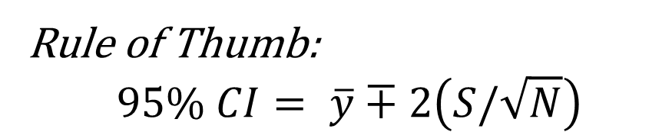
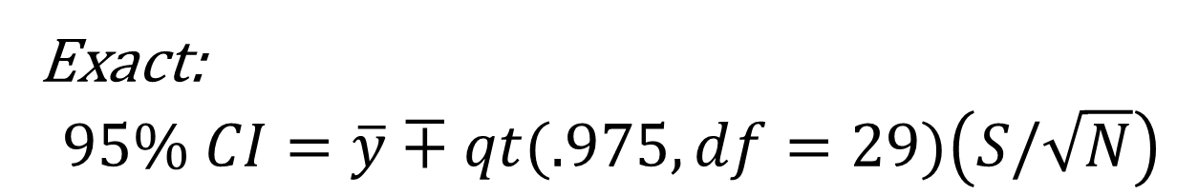
One Sample T-test
Example: The mean weight of abalone sold at market in a package is listed as 500g, you want to check if the abalone sold in the market have a mean of 500g. You have a sample of 30 abalone. The mean is 493.6667g and the sample standard deviation 18.02552g.
Rule of Thumb:
$$95\% CI= \overline{y}∓2\left(S/\sqrt{N}\right)$$
Exact:
$$95\% CI=\overline{y}∓qt(.975,df=29)\left(S/\sqrt{N}\right)$$

Slide 29
Paired T-test
Similar to doing a one-sample T-test on the differences between the pairs
Differences need to independent of one another
Differences approximately follow a normal distribution

Slide 30
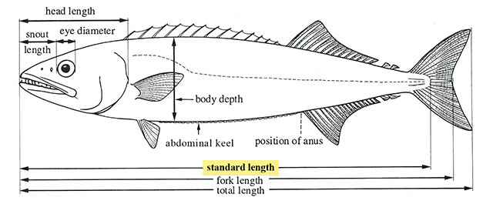
Paired T-test
We are curious if white seabass have a deep tail. We can tell measure the "deepness" of the tail by looking at the difference between total length of the fish and standard length. We consider a tail deep if it is more than 1/6 of the body length of the fish.
R script time
http://www.fishbase.org/Images/Glospic/G_Fig13a6181_SL.jpg

Slide 31
Two Sample T-test
If we want to compare if the means from two samples are the same.
Two types of test
Homogeneous variances
Heterogeneous variances
Can determine which one you have using a test to see if the variances are similar.

Slide 32
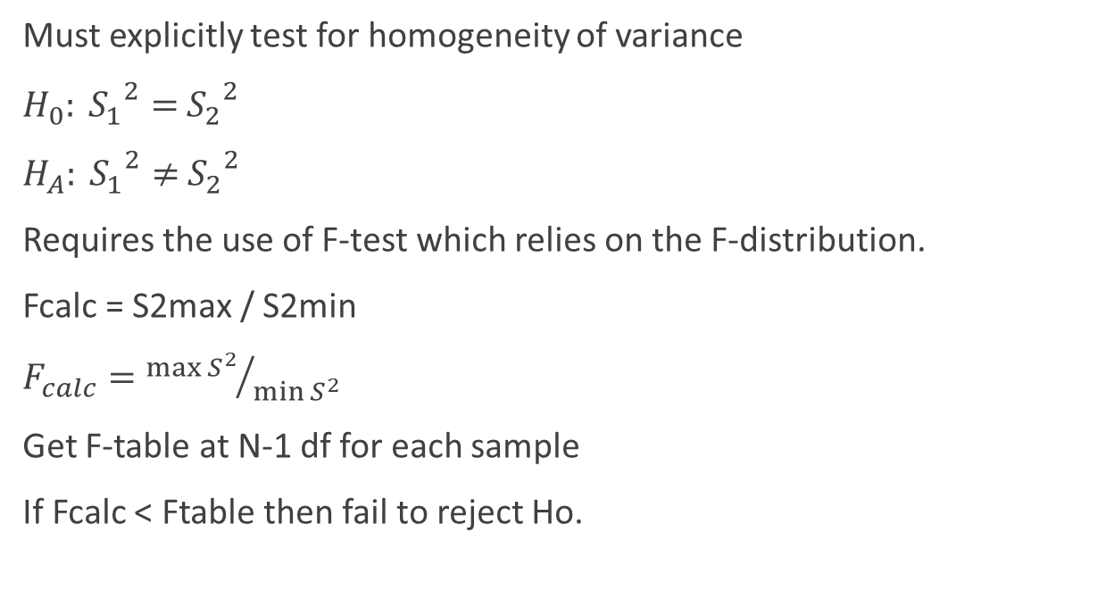
Two Sample T-test Test for Homogeneity of Variances
Must explicitly test for homogeneity of variance
$H_{0}: {S_{1}}^{2}=$ ${S_{2}}^{2}$
$H_{A}: {S_{1}}^{2}≠$ ${S_{2}}^{2}$
Requires the use of F-test which relies on the F-distribution.
Fcalc = S2max / S2min
$F_{calc}={\max{S^{2}}}/{\min{S^{2}}}$
Get F-table at N-1 df for each sample
If Fcalc < Ftable then fail to reject Ho.

Slide 33
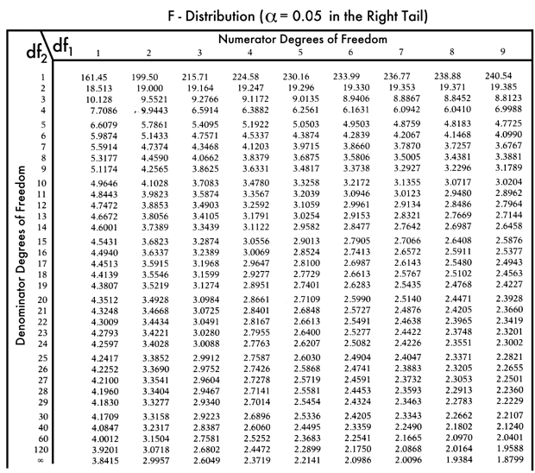
Two Sample T-test Test for Homogeneity of Variances
Must explicitly test for homogeneity of variance
$H_{0}: {S_{1}}^{2}=$ ${S_{2}}^{2}$
$H_{A}: {S_{1}}^{2}≠$ ${S_{2}}^{2}$
Requires the use of F-test which relies on the F-distribution.
Fcalc = S2max / S2min
$F_{calc}={\max{S^{2}}}/{\min{S^{2}}}$
Get F-table at N-1 df for each sample
If Fcalc < Ftable then fail to reject Ho.
http://www.statisticslectures.com/images/ftable3.gif

Slide 34
Two Sample T-test Test for Homogeneity of Variances
Must explicitly test for homogeneity of variance
$H_{0}: {S_{1}}^{2}=$ ${S_{2}}^{2}$
$H_{A}: {S_{1}}^{2}≠$ ${S_{2}}^{2}$
Requires the use of F-test which relies on the F-distribution.
Fcalc = S2max / S2min
$F_{calc}={\max{S^{2}}}/{\min{S^{2}}}$
Get F-table at N-1 df for each sample
If Fcalc < Ftable then fail to reject Ho.
using R:
var.test(x,y)

Slide 35
Two Sample T-test Test for Homogeneity of Variances
The F-test for variance requires that the two samples are drawn from normal populations (i.e., must test normality assumption first).
If the two samples are not normally distributed, do not use Variance Ratio F-test !
Use the Modified Levene Equal-Variance Test.
not currently available as a built in function in R- so we won’t cover it here

Slide 36
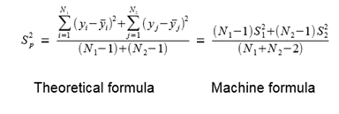
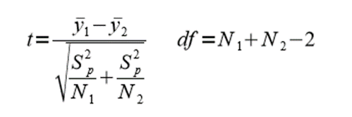
Two Sample T-test Homogeneous Variances
If Fcalc < Ftable then fail to reject Ho (p-value > 0.05).
Begin by calculating the mean & variance for each of your two samples.
Then determine pooled variance
Determine the test statistic and go to table.

Slide 37
Two Sample T-test Homogeneous Variances
We want to compare the weights of rays in two sites, B and G. We have the weights recorded in kg in the file "ray.weightskg.csv".
R script time

Slide 38
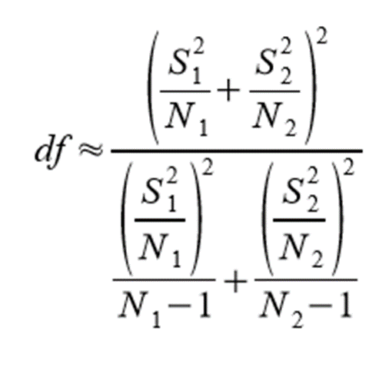
Two Sample T-test Non Homogeneous Variances
If Fcalc ≥ Ftable then reject Ho (p-value ≤ 0.05).
Assuming both data come from a normal distribution, but they have different variances, we can still do a two sample t-test. BUT we need to adjust the degrees of freedom.
Performs the t-test in exactly the same fashion as for homogeneous variances; but, you must enter the table at a different df. Note that this can have a big effect on decision.

Slide 39
Two Sample T-test Non Homogeneous Variances
If Fcalc ≥ Ftable then reject Ho (p-value ≤ 0.05).
R script time

Slide 40
Non-Parametric T-tests
One sample: Kruskal Wallis Test One Way Anova by Ranks
kruskal.test(y~A) # where y1 is numeric and A is a factor
Paired one sample: dependent 2-group Wilcoxon Signed Rank Test
wilcox.test(y1,y2,paired=TRUE) # where y1 and y2 are numeric
Two-sample: Mann-Whitney U Test
wilcox.test(y~A) # where y is numeric and A is A binary factor
wilcox.test(y,x) # where y and x are numeric

Slide 41
Learning Objectives
Apply simple transformations if data are not normal
Data transformation (log)
T-tests: Independent and Paired
Explain when a T-test is appropriate
Explain the assumptions of a T-test
Explain when a paired t-test is appropriate
Non-parametric T-tests

Slide 42

Questions?

Slide 43
References
http://www.unh.edu/halelab/BIOL933/labs/lab6.pdf
http://www.csic.cornell.edu/Elrod/t-test/t-test-assumptions.html
https://www.ohio.edu/plantbio/staff/mccarthy/quantmet/lectures/ttest.pdf
https://www.isixsigma.com/tools-templates/normality/tips-recognizing-and-transforming-non-normal-data/
http://rcompanion.org/handbook/I_12.html

Slide 44
Ways to Test for Normality
There are 5 major tests used:
Shapiro-Wilk W test
Anderson-Darling test
Martinez-Iglewicz test
Kolmogorov-Smirnov test
D’Agostino Omnibus test
NB: Power of all is weak if N < 10

Slide 45
Shapiro Wilk W Test
Developed by Shapiro and Wilk (1965).
One of the most powerful overall tests.
It is the ratio of two estimates of variance (actual calculation is cumbersome; adversely affected by ties).
Test statistic is W; roughly a measure of the straightness of the quantile-quantile plot. The closer W is to 1, the more normal the sample is.
Available in R and most other major stats applications.
shapiro.test(x)

Slide 46
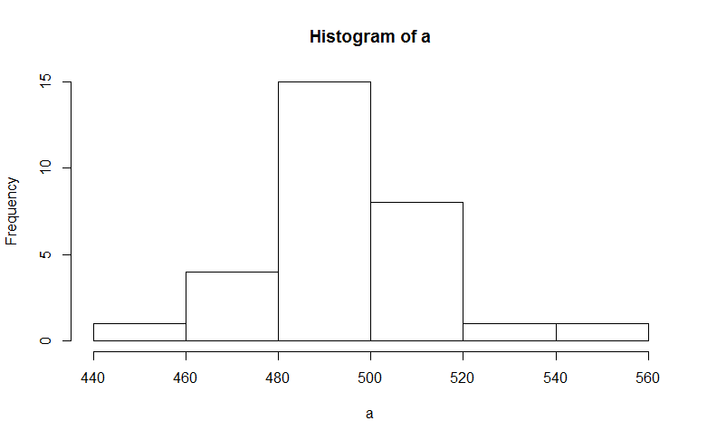
Shapiro Wilk W Test
shapiro.test(a)
R script time
p>0.05 means fail to reject the null (null is that distribution is normal

Slide 47
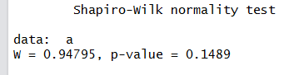
Shapiro Wilk W Test
shapiro.test(a)
p>0.05 means fail to reject the null (null is that distribution is normal

Slide 48
Anderson-Darling Test
Martinez-Iglewicz test
Developed by Anderson and Darling (1954).
Very popular test.
Based on EDF (empirical distribution function) percentile statistics.
Almost as powerful as Shapiro-Wilk W test.
Package ‘nortest’ has it as ad.test(x)
Based on the median & robust estimator of dispersion.
Very powerful test.
Works well with small sample sizes.
Particularly useful for symmetrically skewed samples.
A value close to 1.0 indicates normality.
Strongly recommended during EDA.
Package ‘PoweR’ (not easy to use)

Slide 49
Kolmogorov-Smirnov test
D’Agostino Omnibus test
Calculates expected normal distribution and compares it with the observed distribution.
Uses cumulative distribution functions.
Based on the max difference between two distributions.
Poor for discrimination below N = 30.
Power to detect differences is low. Historically popular.
ks.test(x, ”pnorm”, mu, sd)
Based on coefficients of skewness (√b1) and kurtosis (b2).
Provides separate tests for skew and kurtosis
Skewness test requires N ≥ 8 –
Kurtosis test best if N > 20
Provides combined Omnibus test of normality.
Package ‘moments’ agostino.test(x)

